Slide 1
E-R model

Slide 2
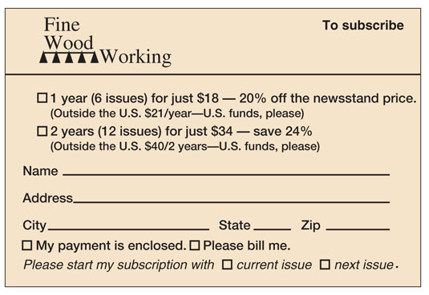
5.1 Examine the subscription form shown in Figure 5-53. Using the structure of this form, do the following

Slide 3
A. Create a model with one entity. Specify the identifier and attributes.

Slide 4
B.Create a model with two entities, one for customer and a second for subscription. Specify identifiers, attributes, relationship name, type, and cardinalities.

Slide 5
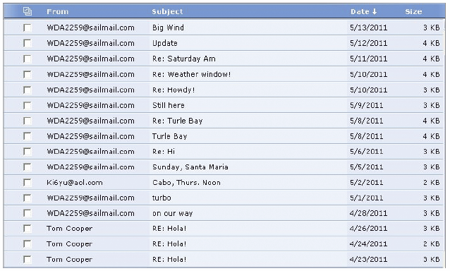
5.2 Examine the list of e-mail messages in Figure 5-55. Using the structure and example data items in this list, do the following:

Slide 6
A.Create a single-entity data model for this list. Specify the identifier and all entities.

Slide 7
B. Modify your answer to A to include entities SENDER and SUBJECT. Specify the identifiers and attributes of entities and the type and cardinalities of the relationships. Explain which cardinalities can be inferred from Figure 5-55 and which need to be checked out with users.

Slide 9
C. The e-mail address in the From column in Figure 5-55 is in two different styles. One style has the true e-mail address; the second style (e.g., Tom Cooper) is the name of an entry in the user's e-mail directory. Create two categories of SENDER based on these two styles. Specify identifiers and attributes.

Slide 11
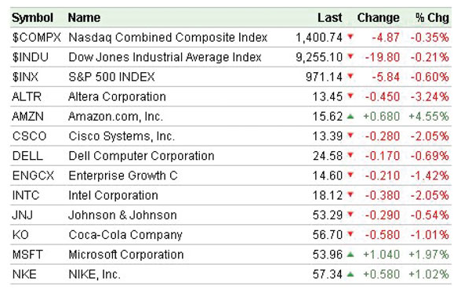
5.3 Examine the list of stock quotes in Figure 5-56. Using the structure and example data items in this list, do the following:

Slide 12
A.Create a single-entity data model for this list. Specify the identifier and attributes.

Slide 13
B. Modify your answer to A to include the entities COMPANY and INDEX. Specify the identifier and attributes of the entities and the type and cardinalities of the relationships. Explain which cardinalities can be inferred from Figure 5-56 and which need to be checked out with users.

Slide 15
C. The list in Figure 5-56 is for a quote on a particular day at a particular time of day. Suppose that the list were changed to show closing daily prices for each of these stocks and that it includes a new column: QuoteDate. Modify your model in B to reflect this change.

